Slide 1
KittyBot
Group 5
Stephen Barth - EE
Bryen Buie - CpE
Carlos Garzon - CpE
Trenton Williams - EE

Slide 3
Motivations
Every six in 10 Americans are pet owners
Census done by the Humane Society of the United States shows that there are 86.4 million cats in households around the United States
Pet owners want to see their cats play
Many pet toys exist; we want to create our own

Slide 4
Goals and Objectives
Create an autonomous pet toy, mainly for cats
Be enticing for pets to play with
Must be durable enough to withstand play from cats or similarly size animals
Be able to move across common household flooring surfaces such as wood, tile, and low carpet
Will be of appropriate size for an indoor, household environment

Slide 5
Specifications
Specification | Value | Constraint/Comment
Maximum Weight | 1 kg | Should not exceed this
Maximum Overall Size | 60 cm³ | Should not exceed this
Battery Life | 60 minutes | On a full charge
Speed | 30 - 50 rpm | Safe speed for indoors
Voltage | 4 - 6 V | Low voltage range

Slide 6
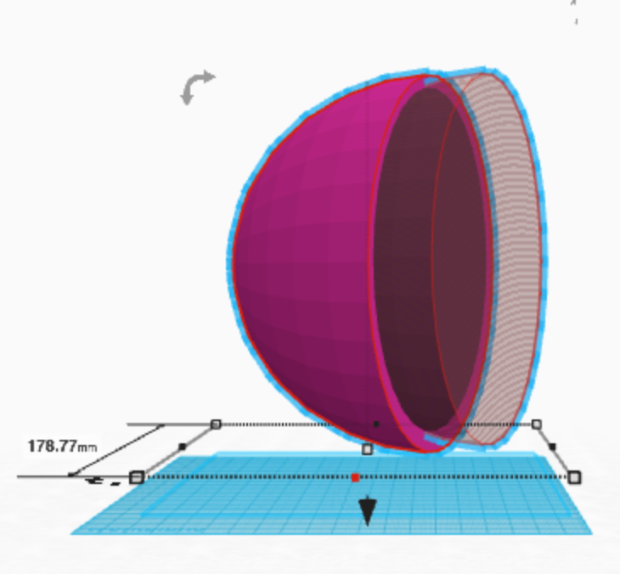
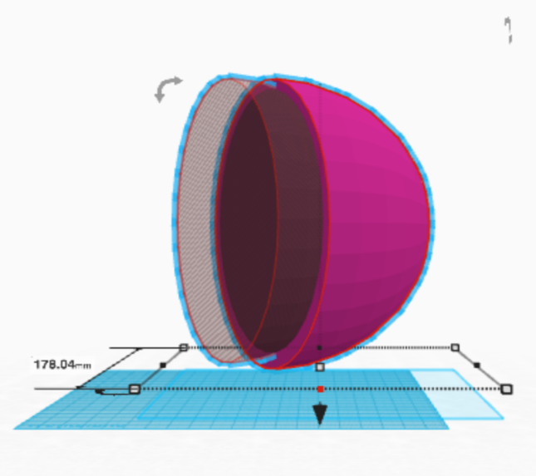
Spherical Design
All components will be encased in a sphere.
A spherical design will protect the electronic components as well as give the device a high degree of maneuverability.
As a sphere, the device will be able to be knocked and rolled around without it being damaged.

Slide 7
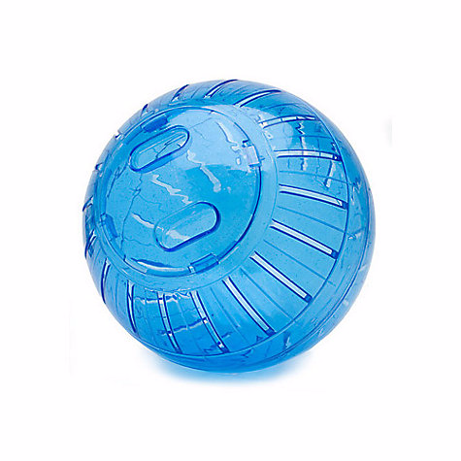
Outer Shell
Hamster Ball
For our prototyping purposes we used a hamster ball, 7” in diameter
+ Cheap, about $7 - $12
+ Easy open lid for reaching inside
- Have to drill holes for mounting
- Difficult to open in the middle

Slide 8
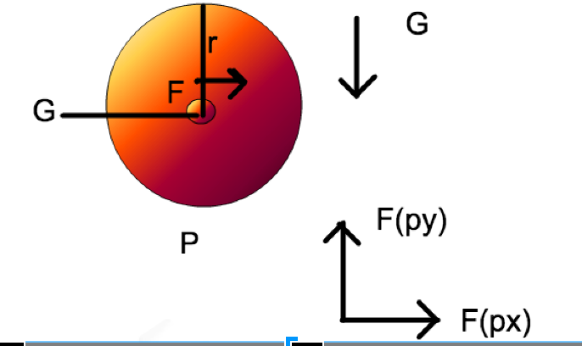
Moving our Robot
Essentially, the ends of our inner device would be spun by the motors, these ends would be bolted to either hemisphere of the sphere which would in turn cause a force “F” which would in turn cause torque.
This would in turn create a force FPx and FPy against the ground “P” which would consequently rotate the sphere.

Slide 9
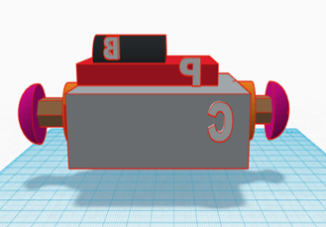
Inner Chassis
Inner chassis will be mounted to the inside of the sphere
Chassis will hold all components including PCB, power supply, counterweight, etc.

Slide 10
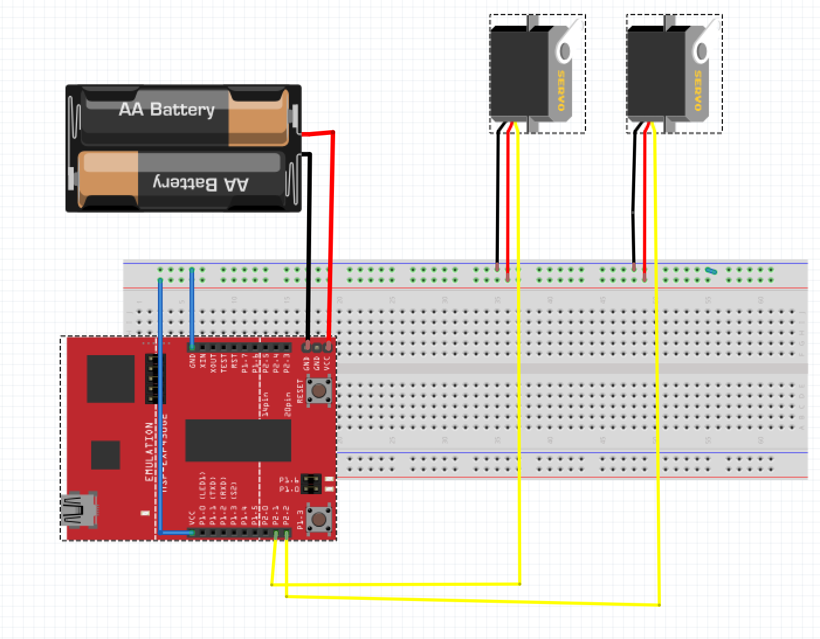
Moving our Robotic Sphere
We decided that the core of the kitty bot senior design project had to be in its simplest state a microcontroller connected to two servo motors.

Slide 11
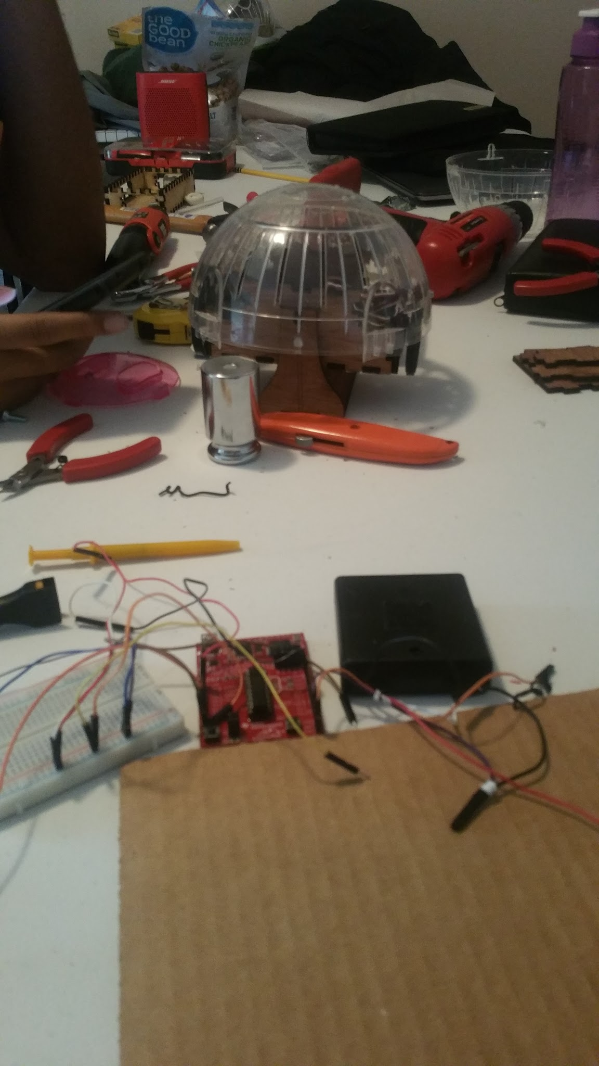
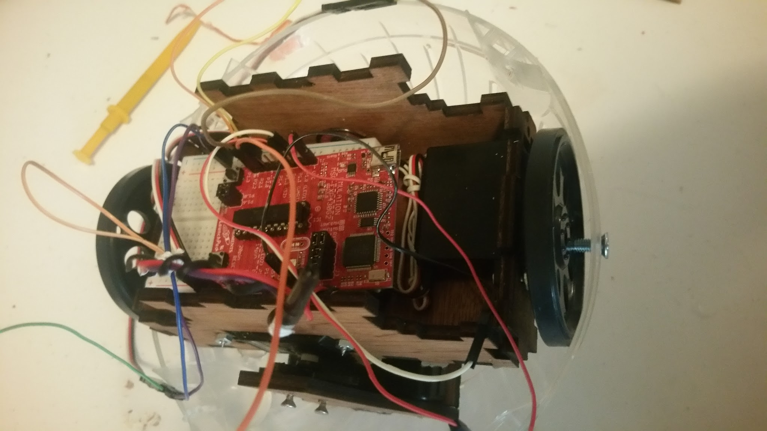
Rapid Prototyping
Minimizing Design Flaws
Saving Cost and Time
Incorporating the Changes Instantly

Slide 12
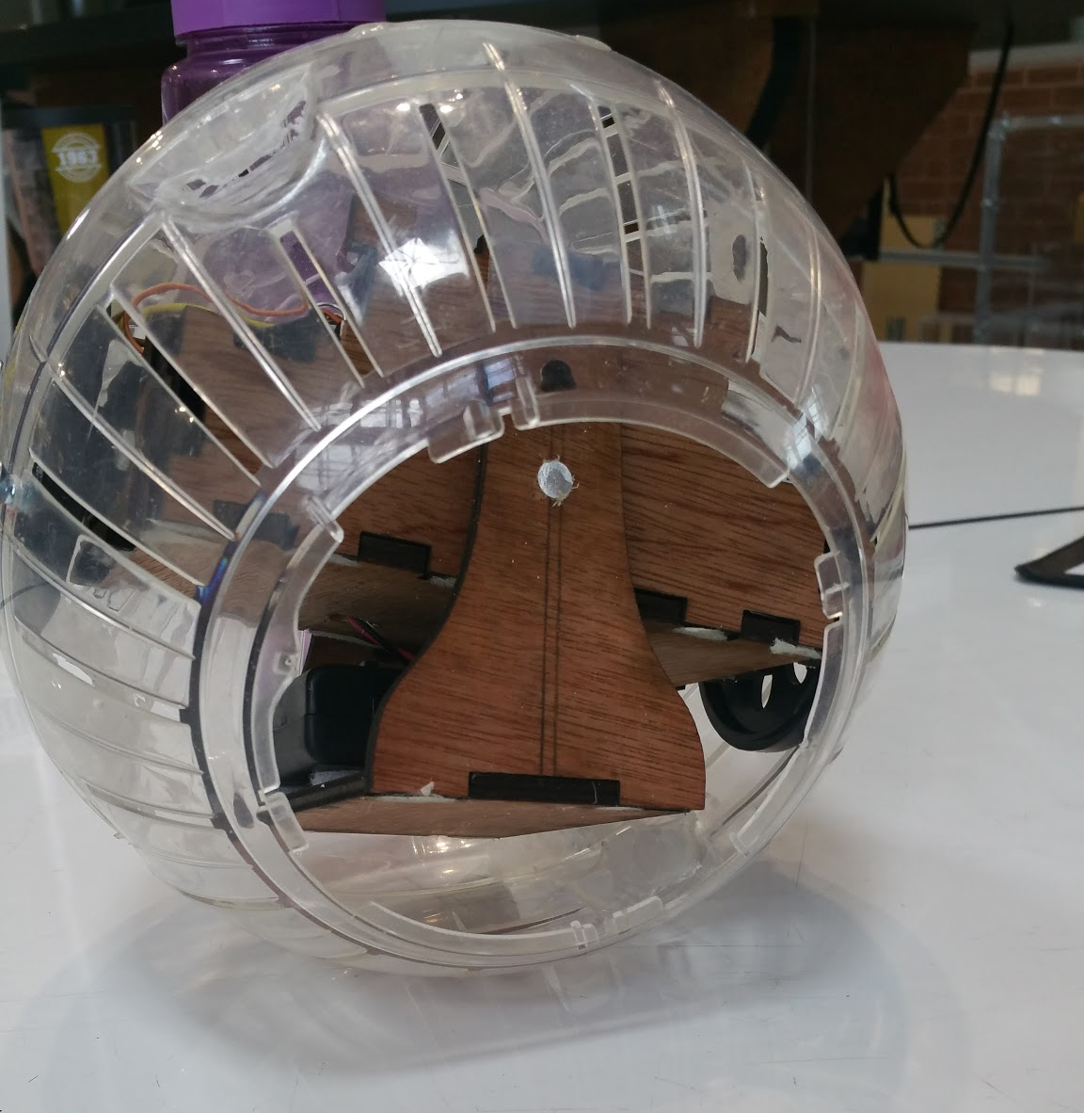
Counterweight
In order to keep the inner chassis upright as the sphere rolls a counterweight will hang from underneath it
The counterweight will eliminate the stuttering movement that would be caused by the inner chassi rotating with the sphere.
Sphere will roll in the direction of its center of mass

Slide 13
Pendulum
Counterweight will act as a pendulum for turning
A servo motor attached to the pendulum will swing it in the desired direction.
Attached to chassis by a servo in the front and bearing in the back, allowing for free rotation
Image by Rotundus GroundBot

Slide 14
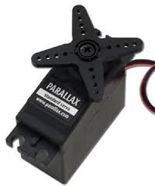
Motors
Parallax Standard Servos
Weighs 44 g
Two servos will connect to opposite ends of the sphere to provide motion
A third will sit in the middle of chassis to control the pendulum

Slide 15
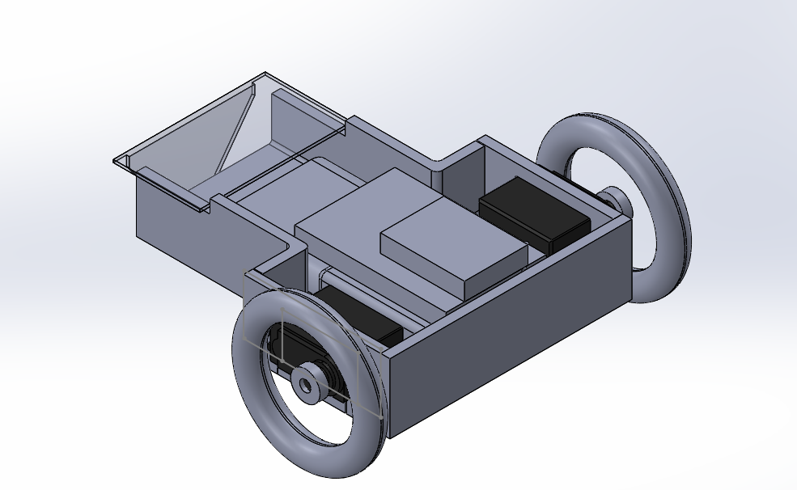
Designing Another Robot
Attaching sensors to our ball design proved to be a tall challenge.
So we designed a separate robot with a 3D printed chassis to hold an ultrasonic sensor
When the sensor detects something, an attached speaker plays a “meow” sound

Slide 16
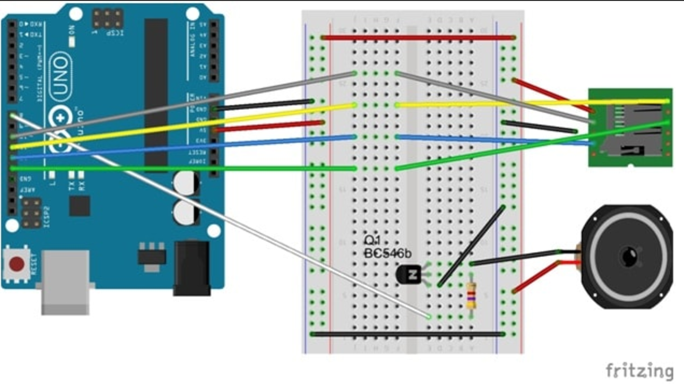
Original Circuit

Slide 17
Simplifying our circuit
down-sample the audio
playback of short (~4 second), low-bitrate (8 KHz) audio sample to increase space
Inside the custom settings, select “Stereo Bit Rate” of 16 KHz, a “Sample Rate” of 8 KHz, and Mono “Channels”
then convert it to a series of numbers that can be pasted into the Arduino program.

Slide 18
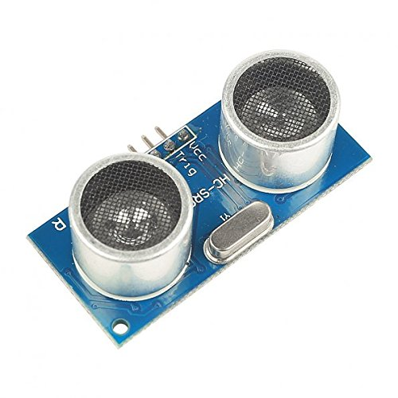
Ultrasonic Sensor
HC-SR04 Ranging Detector Mod Distance Sensor
Range: 2cm - 500cm
Power Supply: 5 V
The sensor will be perched on top of the wheeled robot
When an object is detected, the robot will meow

Slide 19
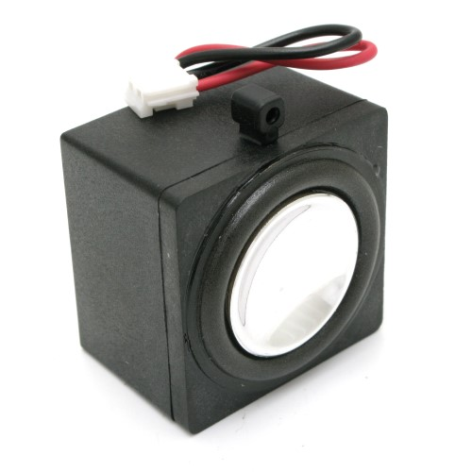
Speaker
8 Ohm Full Range Speaker
Power: 2 Watt
This is the speaker that will produce our “meow” sound effect

Slide 20
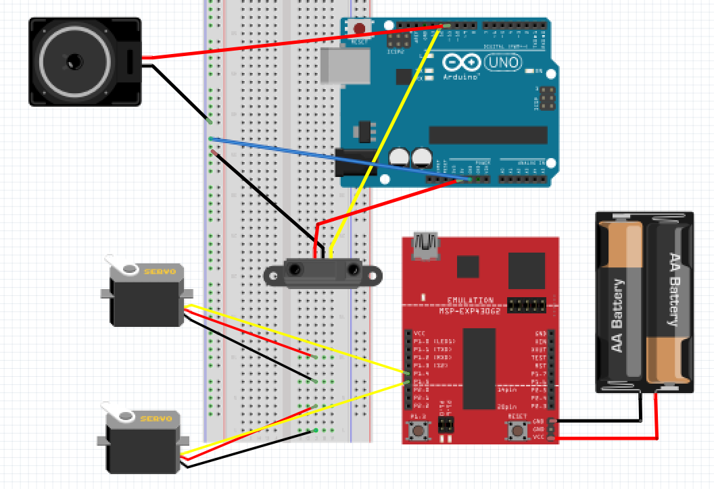
Our second Robot

Slide 21
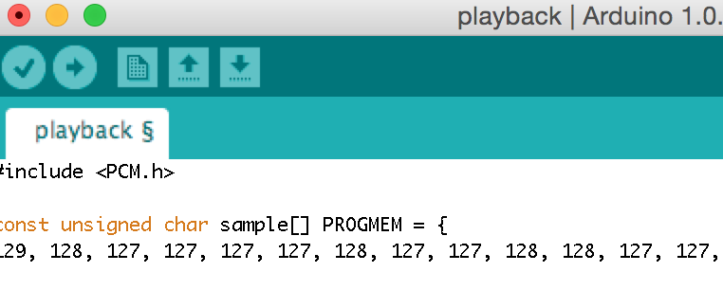
Converted audio file

Slide 22
MSP430G2553
PRO | CON
$12 Energia IDE Low Power Consumption Can use arduino and MSP430 Libraries Online community forums We were already familiar with the device from past endeavors | Relatively Low memory compared to other microcontrollers.

Slide 23
Arduino UNO
PRO | CON
Cheaply priced Native IDE Programmable in C, C++ | Slow clock - 16 MHz

Slide 24
Its intuitive development window and easy-to-use libraries and functions provide developers with perfect rapid prototyping topology
supported by a large, active and friendly online community
Energia desires to stay compatible with both the Arduino API and Wiring language, which again, make it perfect for our rapid prototyping strategy

Slide 25
Git Repository Coding Structure
Frictionless Context Switching. Create a branch to try out an idea, commit a few times, switch back to where you branched from, apply a patch, switch back to where you are experimenting, and merge it in.
Role-Based Codelines. Have a branch that always contains only what goes to production, another that you merge work into for testing, and several smaller ones for day to day work.
Feature Based Workflow. Create new branches for each new feature you're working on so you can seamlessly switch back and forth between them, then delete each branch when that feature gets merged into your main line.
Disposable Experimentation. Create a branch to experiment in, realize it's not going to work, and just delete it - abandoning the work—with nobody else ever seeing it (even if you've pushed other branches in the meantime).

Slide 26
Power
Total Current = 600 mA
Component | Amount | Voltage(V) | Current
DC motors | 3 | 4-6 | 190 mA
Microcontroller | 1 | 1.8-3.6 | 330 μA
Sensor | 1 | 5 | 1 mA

Slide 27
Batteries
Lithium Iron Phosphate(LiFePO₄)
3.2 nominal voltage
2 batteries needed
1250 mAh
36 grams each
Rechargeable
With a 600 mA current draw each type of battery will last just over two hours which exceeds the battery life specification.
Alkaline
1.5 nominal voltage
4 batteries needed
1300 mAh
24 grams each

Slide 28
Battery Selection
Specification | LiFePO₄ | Alkaline
Price |  | ✓
Weight |  | ✓
Size | ✓
How long they last | ✓ | ✓
Efficiency |  | ✓
Overall |  | ✓

Slide 29
Voltage Regulation
A step down voltage regulator is used to supply other components that require less voltage with the proper amount of voltage without having to use another power source.
A pnp transistor will be used to amplify the voltage created from the piezo sensor being compressed in order to allow the MSP430G2553 to detect the voltage.

Slide 30
LM3940
Input Voltage: 4.5 - 5.5V
Regulates Voltage to 3.3V
Output Current: 1 A
Short Circuit Protected

Slide 31
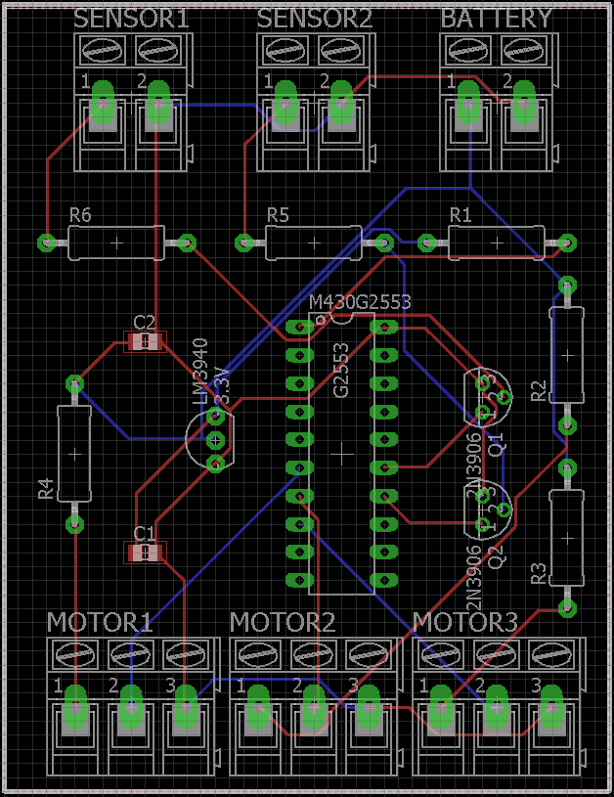
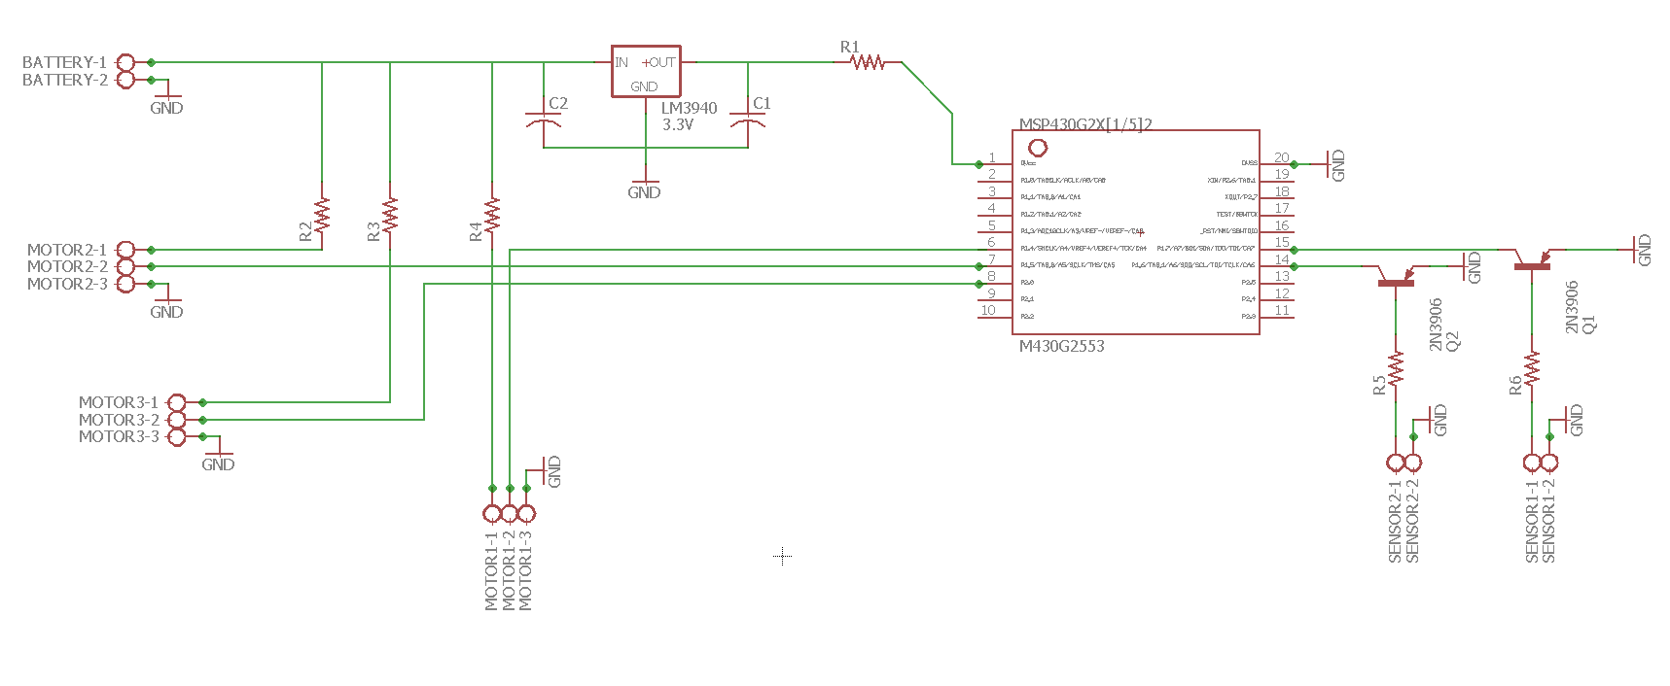
PCB Design Process
Simulation > Breadboarding > Schematic Design > Physical PCB
Research is important. Had to learn how to solder.
Careful planning and consideration
Revise and improve

Slide 32
PCB Design
Schematic created in Eagle
PCBs were ordered from oshpark.com
Standard Specifications
Cost | $30
Max width | 2.5“
Max length | 4“
Shipping time | 14 business days

Slide 33
PCB Schematic

Slide 34
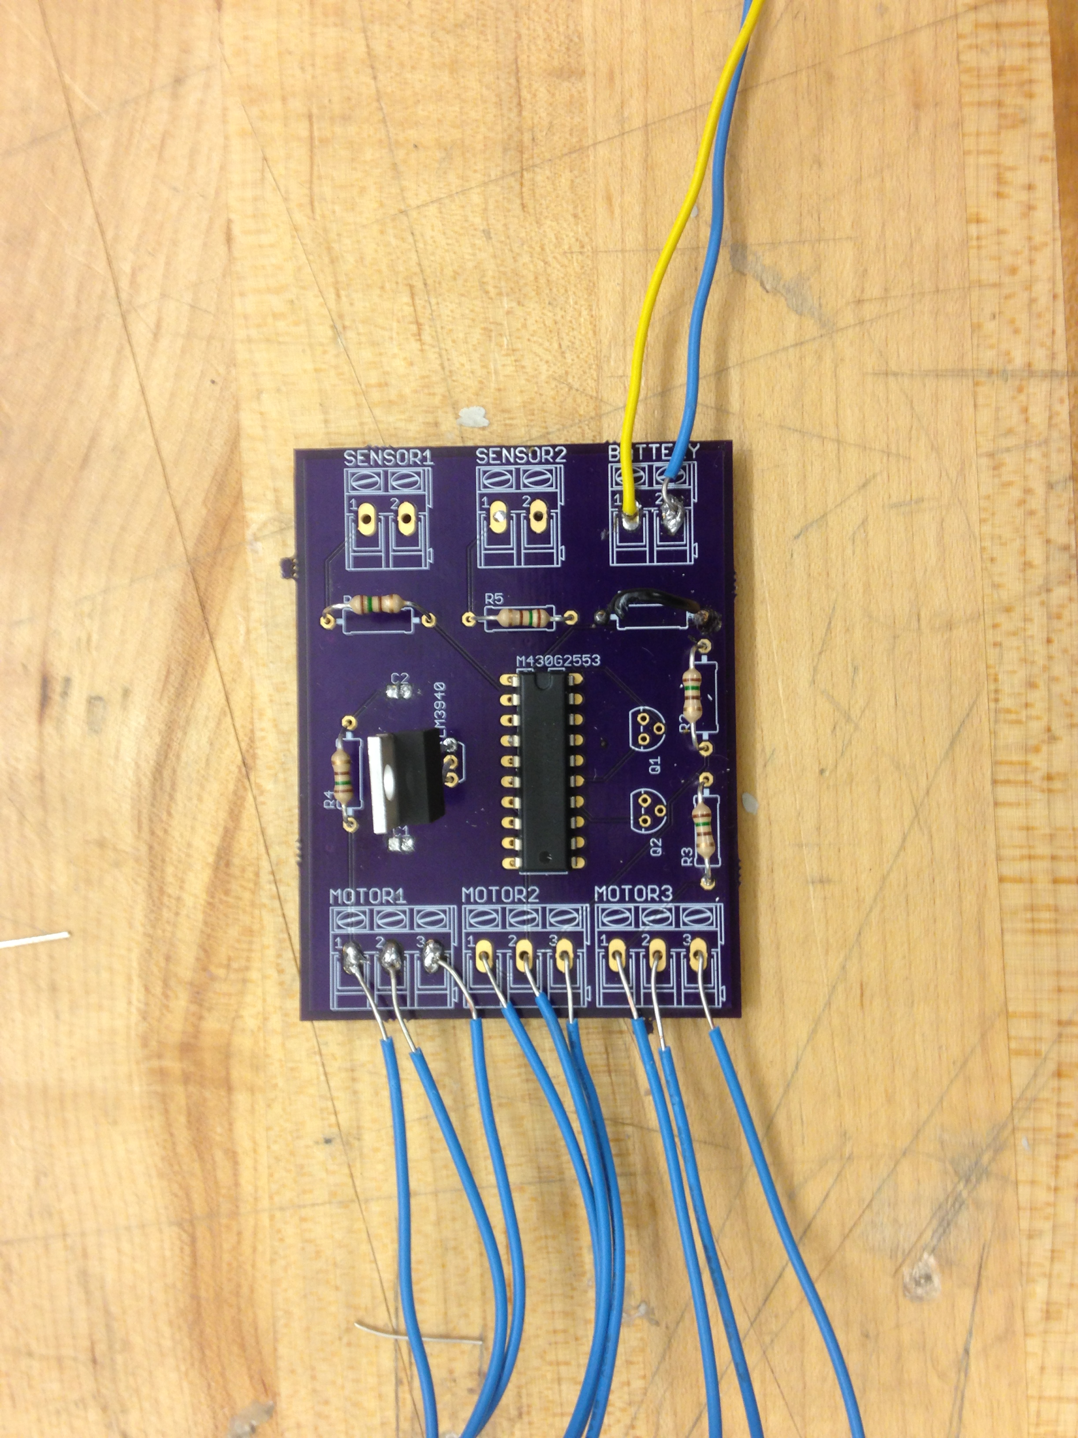
PCB Layout
Dimensions:
2.15 inches wide
2.95 inches long
6 resistors - 10 ohms
2 capacitors - .47 uF & 33uF
2 transistors - 2N3906
1 voltage regulator - LM3940

Slide 35
Work Distribution
 | PCB Design | Structural Design | Software Design | Power Supply | Embedded Systems
Stephen | S |  |  | P
Bryen |  | P | S |  | S
Carlos |  | S | P | S | P
Trenton | P |  |  | S
P - Primary S - Secondary

Slide 36
Budget
Part | Cost
PCB | $30
Microcontroller | $0
Casing | $20
Power supply components and batteries | $20
Chassi to hold system | $10
Wheels | $20
Total | $100

Slide 37
Project Milestones
Date | Milestones
9/26/16 | Test sensors, collect and graph data
9/29/16 | Build PCB and other protective circuits
10/17/16 | Test and modify algorithm
10/24/16 | Build test area for kitten to play in
11/3/16 | Midterm Demo
11/7/16 | Reinforce chassis if any weak spots are discovered
11/14/16 | Make sure project meets expectations and is working as intended
11/30/16 | Final Presentation

Slide 38
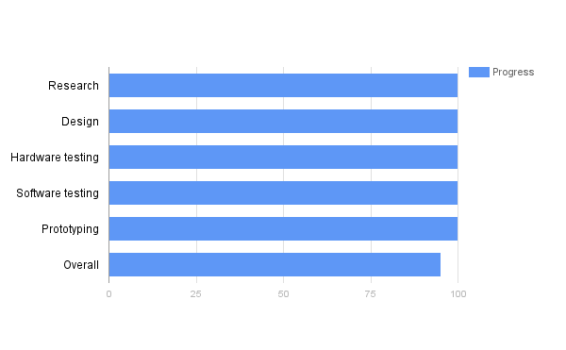
Progress

Slide 39
Issues
Testing the hamsterball prototype.
Indentations inside the ball would catch the chassis stunting movement
Testing the sensitivity of piezo sensors.
PCB issues
voltage passing through but unable to be received by microcontroller
pulse-width modulation

Slide 40
Video

Slide 41
Questions?

